Slide 1


Modeling the Periodic Variations in Music Signals
Presentation and Analysis by: Joey Gadbois
STAT 560: Nonparametric Statistics

Slide 2
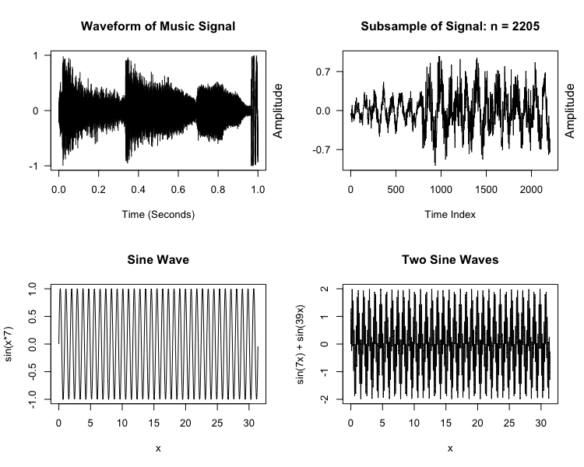
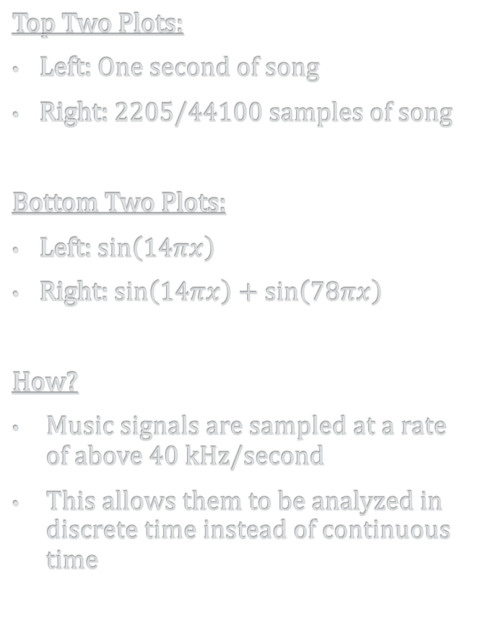
Music = Statistics? Really? How?...
Top Two Plots:
Left: One second of song
Right: 2205/44100 samples of song
Bottom Two Plots:
Left: $\sin\left(14πx\right)$
Right: $\sin\left(14πx\right)+\sin\left(78πx\right)$
How?
Music signals are sampled at a rate of above 40 kHz/second
This allows them to be analyzed in discrete time instead of continuous time

Slide 3

Data: ♫ ♪ Closer – The Chainsmokers ♪ ♫
Electronic songs typically have a drop, where there are no words
Closer is a song from 2016 that was very popular
I am assuming most people know it or have at least heard of it

Slide 4
Nonparametric Statistics to Model Music Signals
Loess Regression
Loess regression models periodic data such that the response function is estimated in local neighborhoods
In each neighborhood, a polynomial regression function is estimated
The estimated curve varies in smoothness depending on a smoothing parameter
Smoothing parameters can be user defined or automatically fit via AICC minimization
Thin-Plate Smoothing Splines
Thin-Plate splines model periodic data considers all possible functions attempting to minimize the residual sum of squares
It is possible to estimate a function that essentially connects all the points, resulting in a deterministic relationship
To combat this issue, a smoothing penalty is implemented to guarantee the estimated response function is m-times differentiable
Note:
Both methods stated above are estimated in attempt to capture the periodicity in the given data
Neither method makes any assumptions regarding the distribution of error terms as parametric regression does

Slide 5
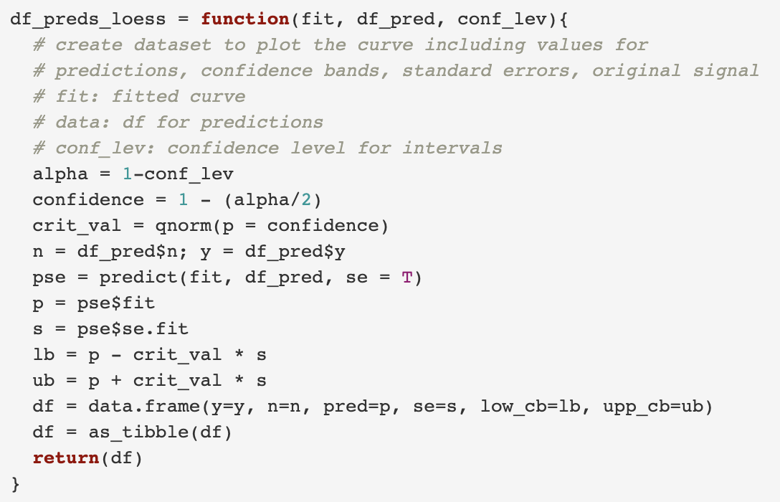
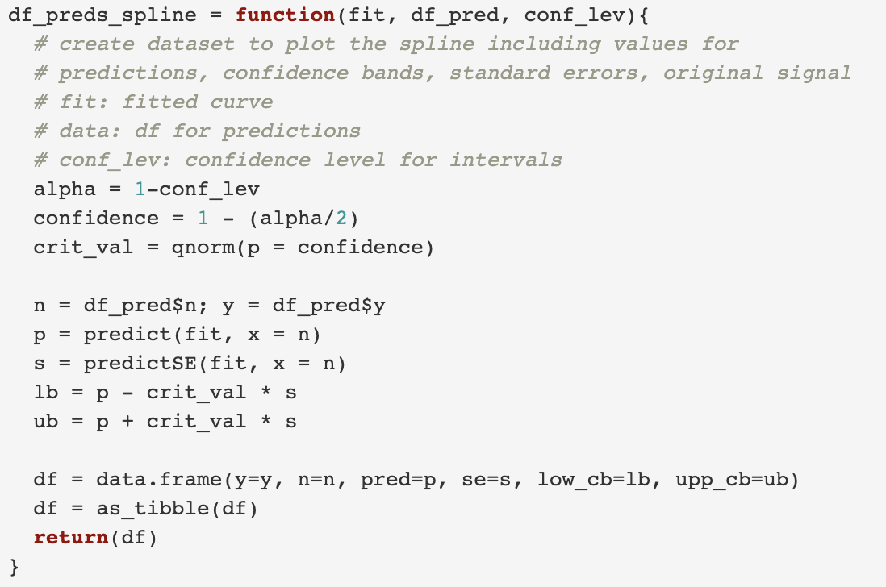
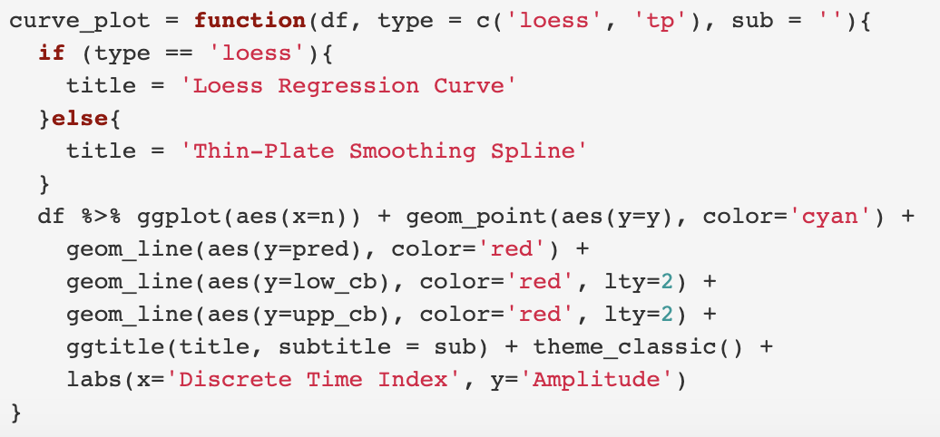
Functions Created in R for Project:
df_preds_loess
curve_plot
df_preds_spline
Functions: df_preds_loess and df_preds_spline takes a fitted loess curve or thin-plate spline, extracts its predictions and confidence bands, then stores the values in a data set to be plotted
Function: curve_plot takes a dataset created from one of the other two functions and plots a scatter plot with the fitted line and confidence bands

Slide 6

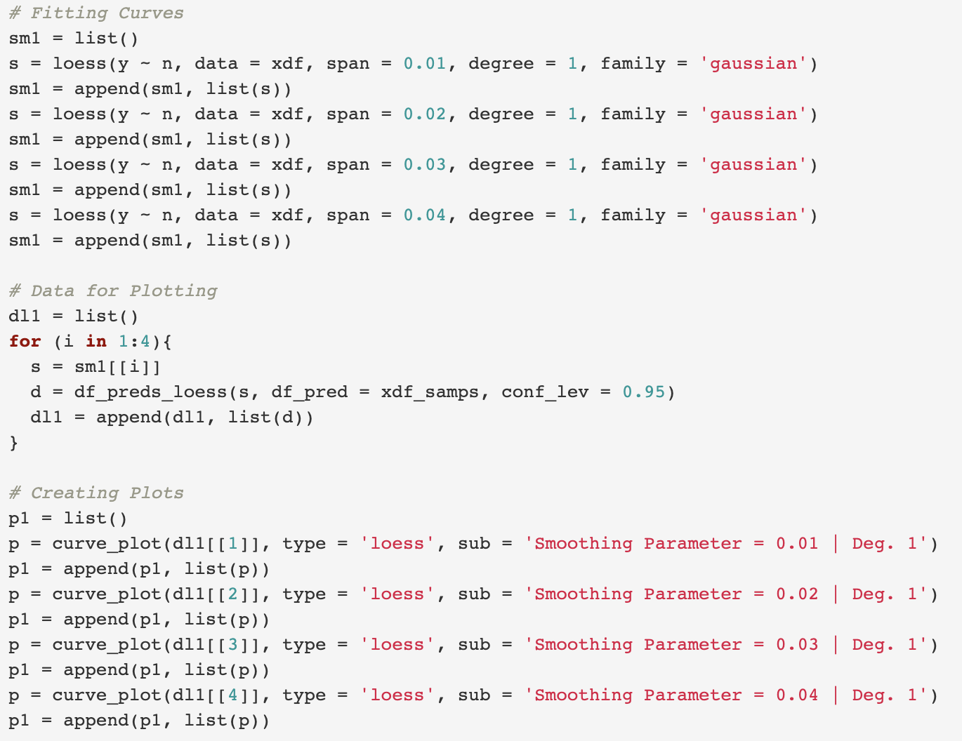
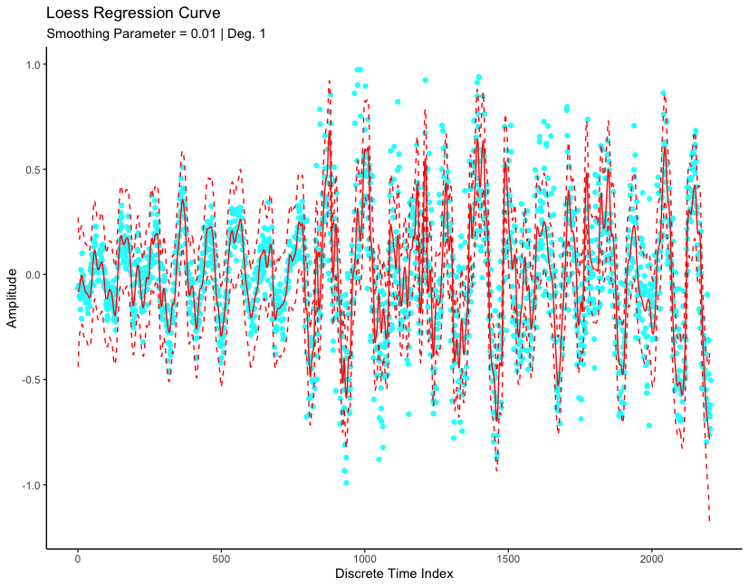
Linear Loess Regression in R Smoothing Parameters: 0.01, 0.02, 0.03, 0.04

Slide 7
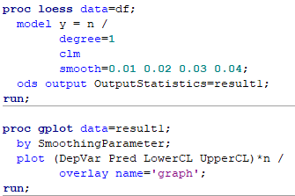
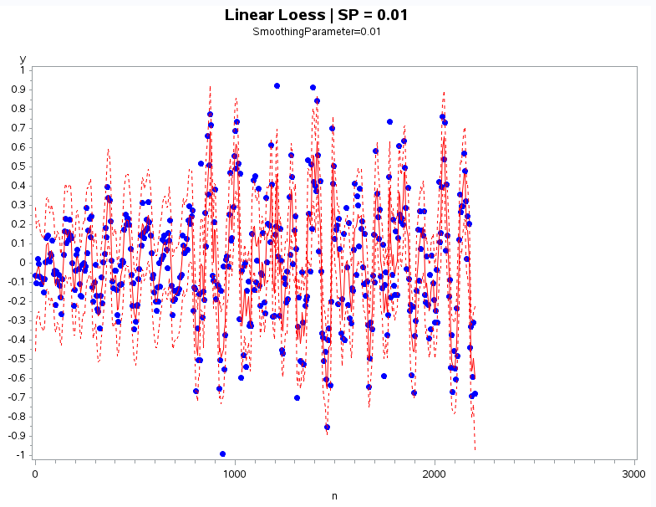
Linear Loess Regression in SAS Smoothing Parameters: 0.01, 0.02, 0.03, 0.04

Slide 8
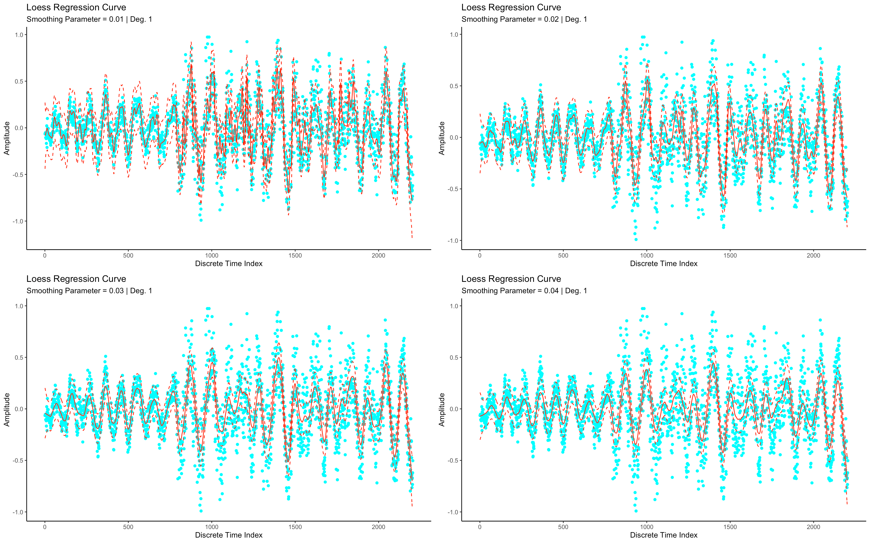
1st Degree Plots for Smoothing Parameters: 0.01, 0.02, 0.03, 0.04
0.01 Smooth:
Most rugged curve, captures most of the points in the confidence bands
0.02 Smooth:
Does a fairly good job at capturing points in confidence bands
0.03 Smooth:
Curve smoothens out, starts to miss a lot of variation
0.04 Smooth:
Curve is the smoothest, but most of the points are not captured in confidence bands

Slide 9
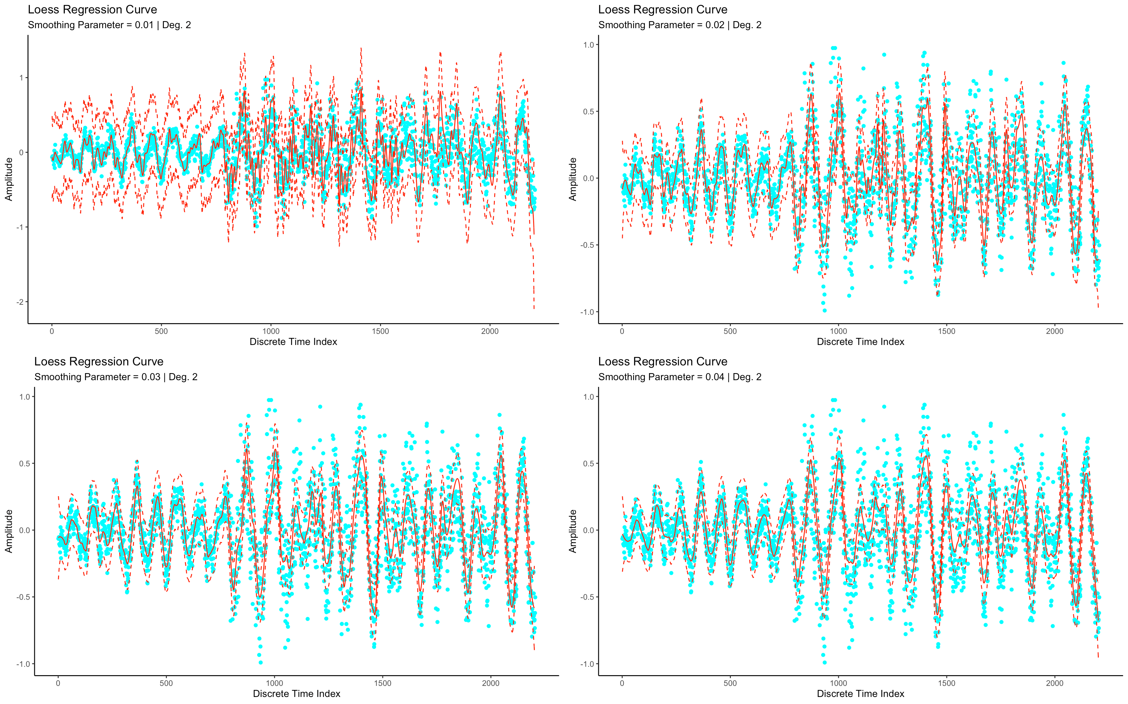
2nd Degree Plots for Smoothing Parameters: 0.01, 0.02, 0.03, 0.04
0.01 Smooth:
Highly variant curve, confidence bands capture almost all points
0.02 Smooth:
Reasonably variant curve, confidence bands miss points with larger variations
0.03 Smooth:
Curve is smooth for the most part, confidence bands miss most points of higher variations
0.04 Smooth:
Similar curve to 0.03, captures about the same variation

Slide 10
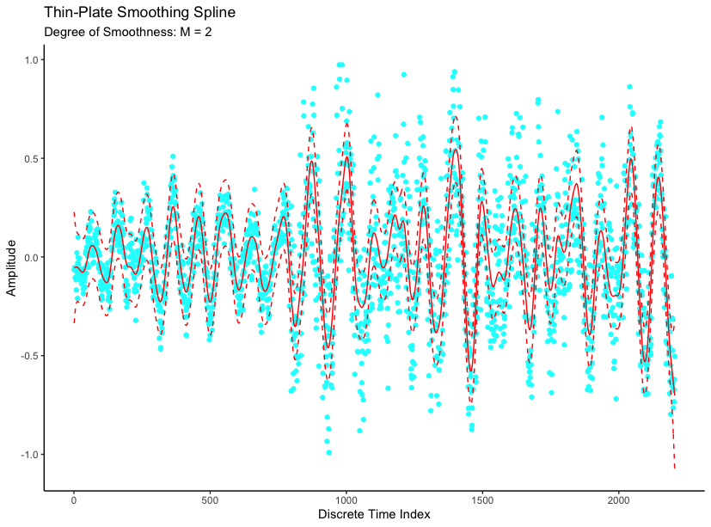
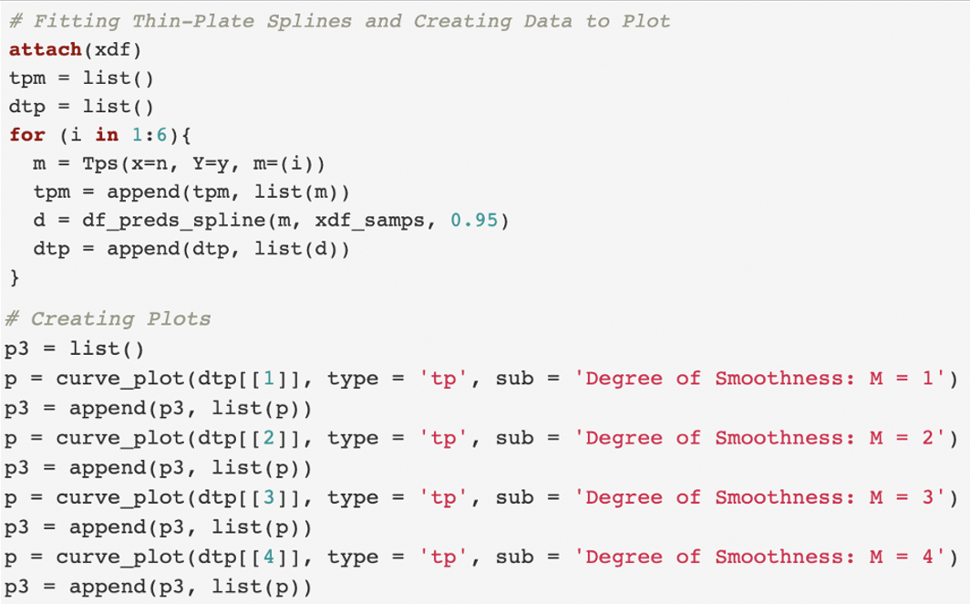
Thin-Plate Smoothing Splines in R Degree of Smoothness: M = 1, 2, 3, 4

Slide 11
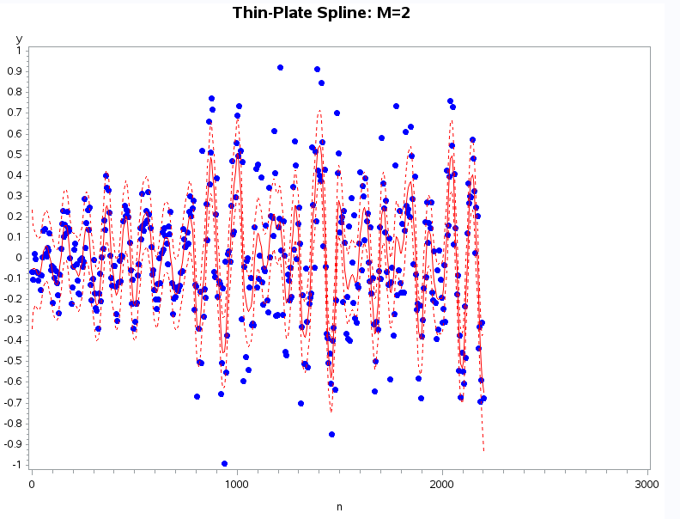
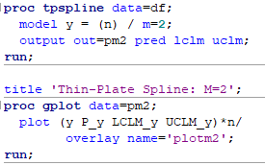
Thin-Plate Smoothing Splines in SAS Degree of Smoothness: M = 1, 2, 3
Repeat for all M

Slide 12
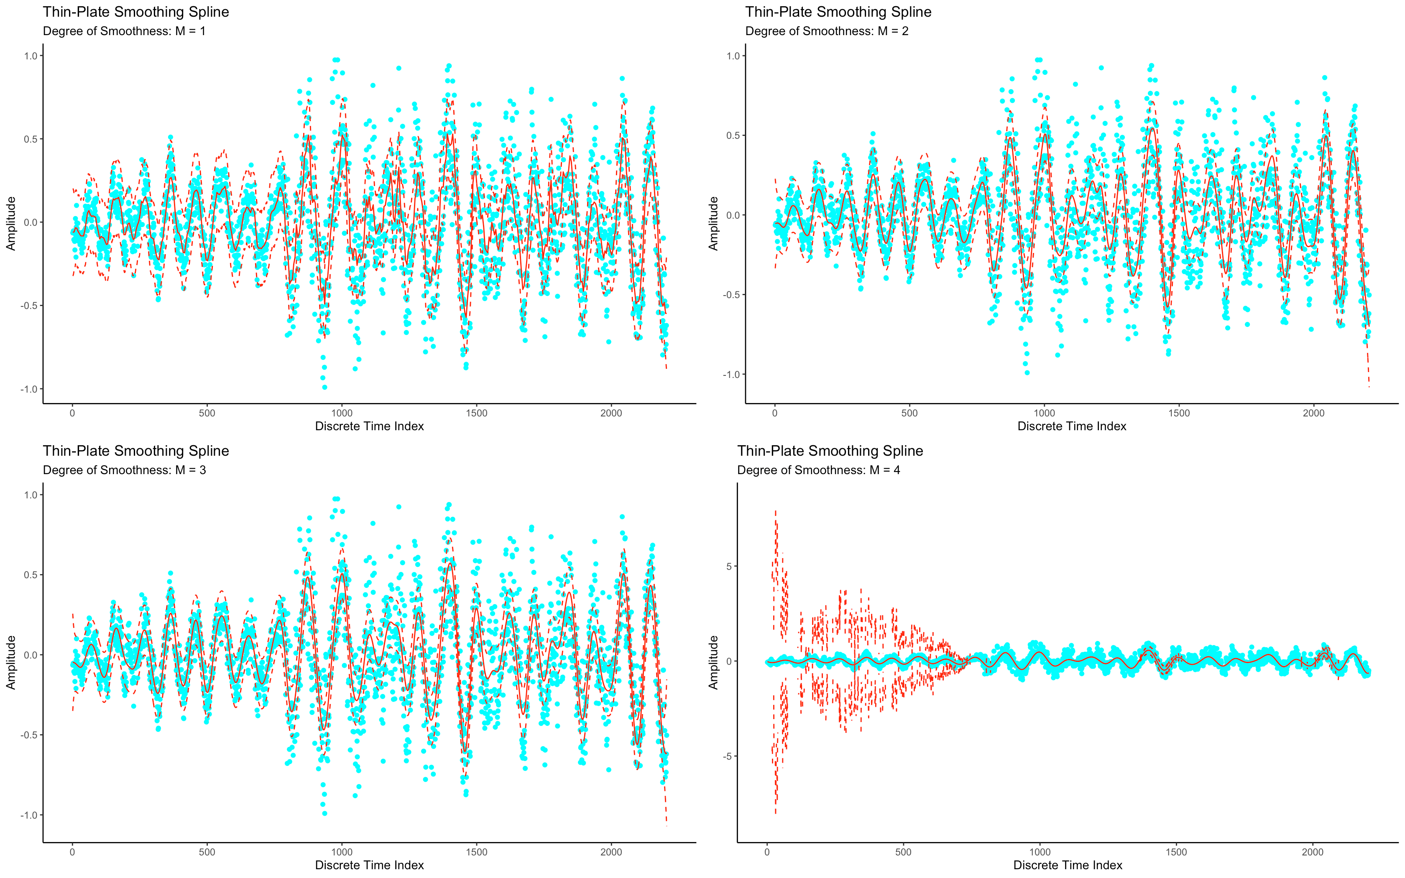
Thin-Plate Splines for Smoothers: M = 1, 2, 3, 4
M = 1:
Very rugged curve, captures most points except high variation
M = 2:
Curve with smooth appearance, captures fair amount of points in confidence bands
M = 3:
Smooth curve, captures fair amount of points in confidence bands
M = 4:
Very smooth curve, follows the general periods, misses most points, confidence bands have extreme amplitude

Slide 13
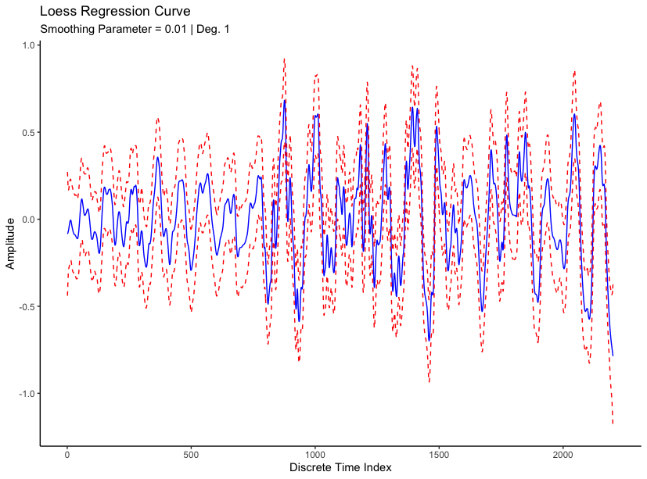
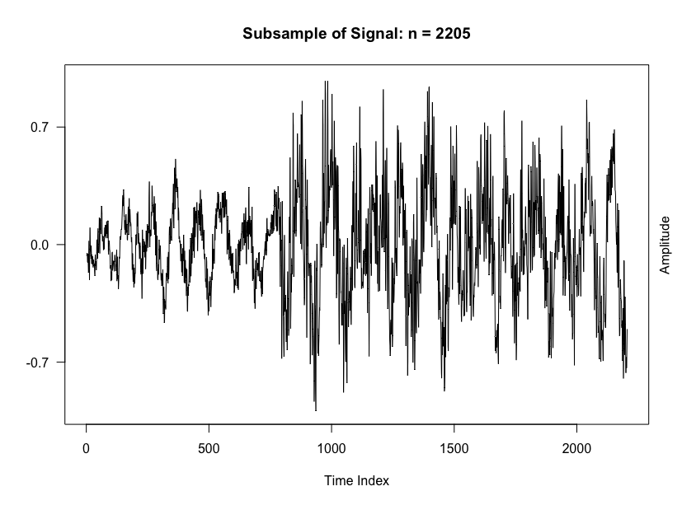
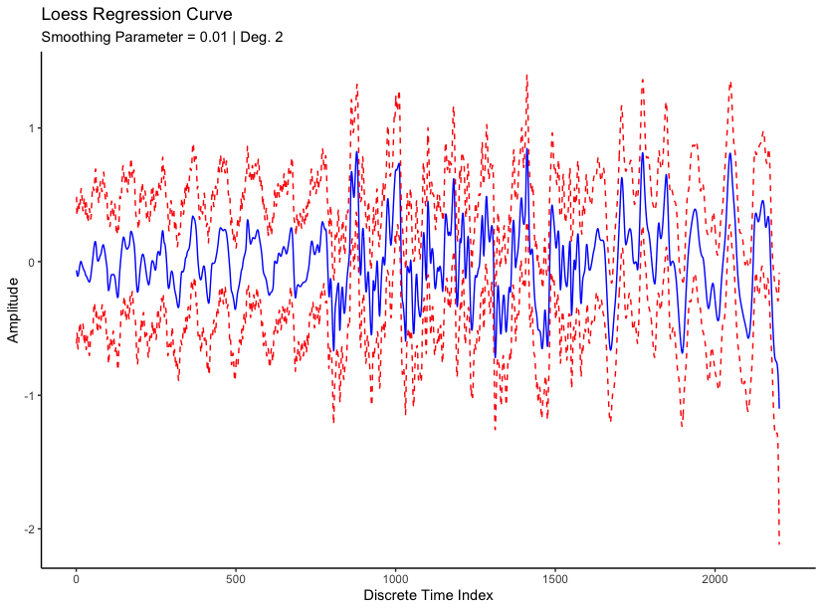
Real Signal vs. Loess Curves:

Slide 14
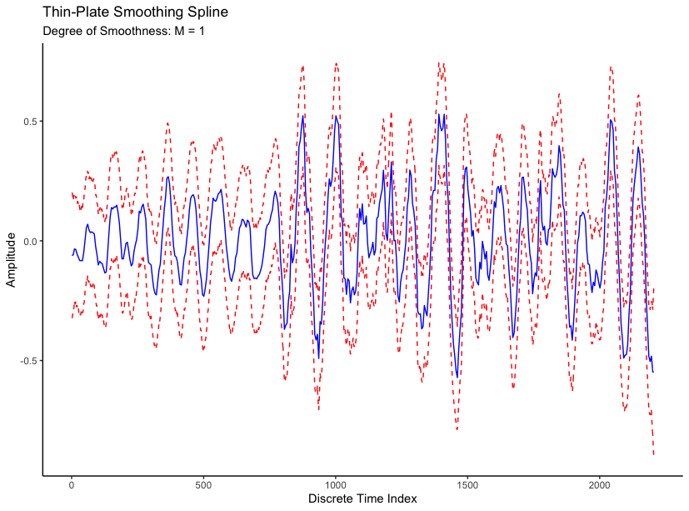
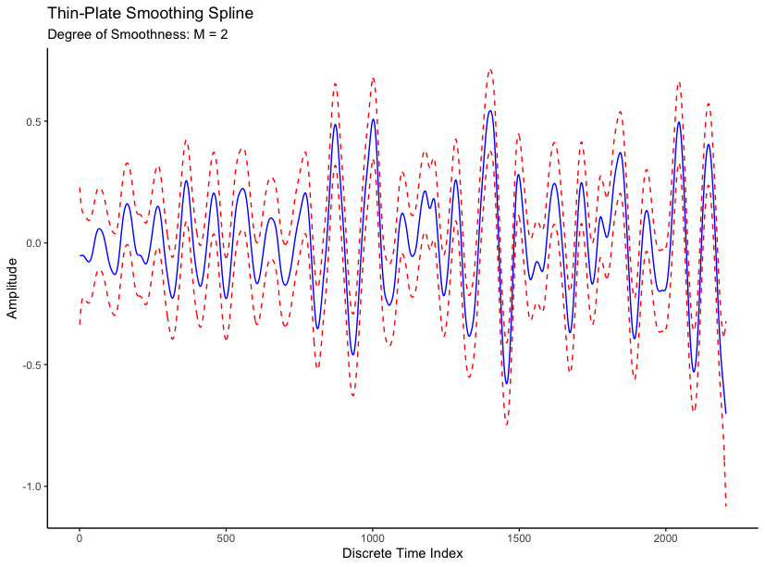
Real Signal vs. Thin-Plates:

Slide 15




Dr. Olga and STAT 560 Classmates, THANK YOU FOR LISTENING!! Joey Gadbois Code will be on GitHub Shortly for anyone interested: github.com/jgadbois17

